Slide 1


Sally Huang | Dwayne McFarlane | Francisco Paulino | Simone Tobias
Notes:
SIMONE
Our client is Urban Leisure. It is a Co-living company.
Explain what coliving is
Coliving is a modern form of housing where residents share living space, have hotel-like amenities, and can network and form a strong coliving community within the living space.
Our Client’s company is currently in Brooklyn and her goals are that she wants to preserve the history of Brooklyn, provide a low-cost, modern coliving experience that also has an educational component to differentiate from other coliving companies, like teaching tenants about homeownership
We started off with screener surveys to find the right users for our client. The main question that help us qualify users for an interview is
“Have you ever lived in or considered living in a coliving community?”. If they answered yes, we took a look at the other answers to their questions and reached out to them to set up a time for an interview.

Slide 2

Sally Huang | Dwayne McFarlane | Francisco Paulino | Simone Tobias
Notes:
SIMONE
Our client is Urban Leisure. It is a Coliving company based in Brooklyn, NY
Coliving is a modern form of communal living in which residents get a private bedroom in a furnished apartment/home with shared common areas.
Coliving is popular in major cities as a means of affordable living for students, workers, digital nomads, or individuals relocating.
Unlike traditional apartments, coliving is attractive to tenants due to affordability, flexibility, building amenities, and a sense of community.
URBAN LEISURE is currently operating in Brooklyn. Using the unique aethetic of Brooklyn, URBAN LEISURE provides a low-cost, modern coliving experience that also has an educational component to differentiate from other coliving companies, specifically teaching tenants about homeownership
We started off with screener surveys to find the right users for our client. The main question that help us qualify users for an interview is

Slide 3
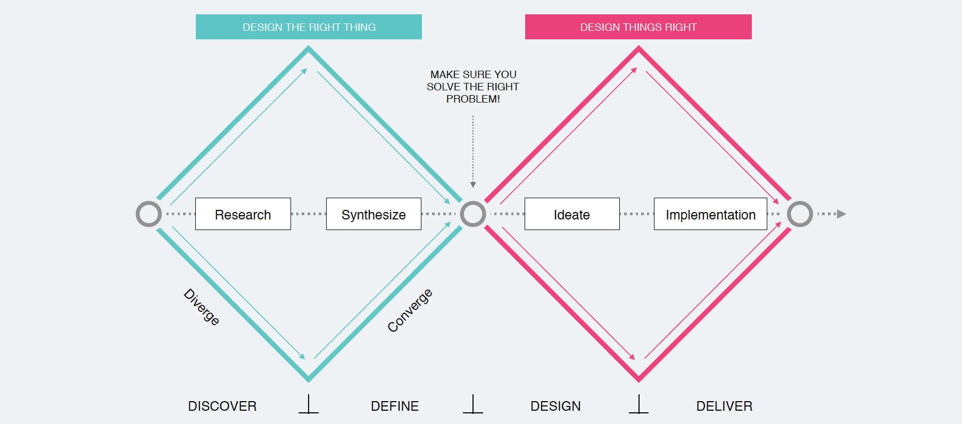
Our Process
DESIGN THE RIGHT THING
DESIGN THINGS RIGHT
DISCOVER
DEFINE
DESIGN
DELIVER
Huang | McFarlane | Paulino | Tobias
Notes:
SIMONE
DISCOVER
Choosing the topic
Identifying the problem
Screener Surveys
User Interviews
DEFINE
Affinity Mapping
User Persona
Problem Statement
Organizational Partnership
Platform Choice
DESIGN
Design Studio
Mid-Fidelity Wireframes
Usability Testing
Hi-Fidelity Mockups
DELIVER Future Iterations

Slide 4
DESIGN THE RIGHT THING
DESIGN THINGS RIGHT
Screener Survey
User Interviews
DISCOVER
DELIVER
DEFINE
DESIGN
Huang | McFarlane | Paulino | Tobias
Notes:
SIMONE
The first part of the process is the DISCOVER PHASE

Slide 5
Screener Survey
DISCOVER
Have you ever lived in or considered living in a coliving community?
Huang | McFarlane | Paulino | Tobias
Notes:
SIMONE

Slide 6
User Interview Questions
DISCOVER
How important is the communal aspect in the co-living experience?
What about coliving attracted you?
Were there any aspects of coliving that you enjoy and didn’t enjoy? Why?
How did you communicate with the landlord?
How did you engage with other tenants?
Huang | McFarlane | Paulino | Tobias
Notes:
SIMONE
Semi-structured, one-on-one interview method where we ask questions of users to get an in-depth understanding of their
•Values •Perceptions •Experiences •Behaviors •Needs •Goals •Pain-points
We interviewed 4 users and here are just some general questions we asked to get to know our user’s co-living experience.
Overall what we found from these general questions - Almost everyone really enjoyed the coliving experience and the communal and social aspect of coliving. Price for rent was a factor as well as location of the co-living space. There were more details about coliving that we found, so With all our data, we synthesized and made an affinity map together.

Slide 7
DESIGN THE RIGHT THING
DESIGN THINGS RIGHT
Affinity Map
User Persona
User Journey Map
DEFINE
DESIGN
DELIVER
Huang | McFarlane | Paulino | Tobias
Notes:
SIMONE

Slide 8
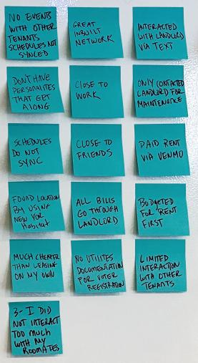


Affinity Map | Step 1
DEFINE
1 User Interview
Notes:
SIMONE
Write down one observation or quote per post-it note. ‣ It’s okay to paraphrase

Slide 9
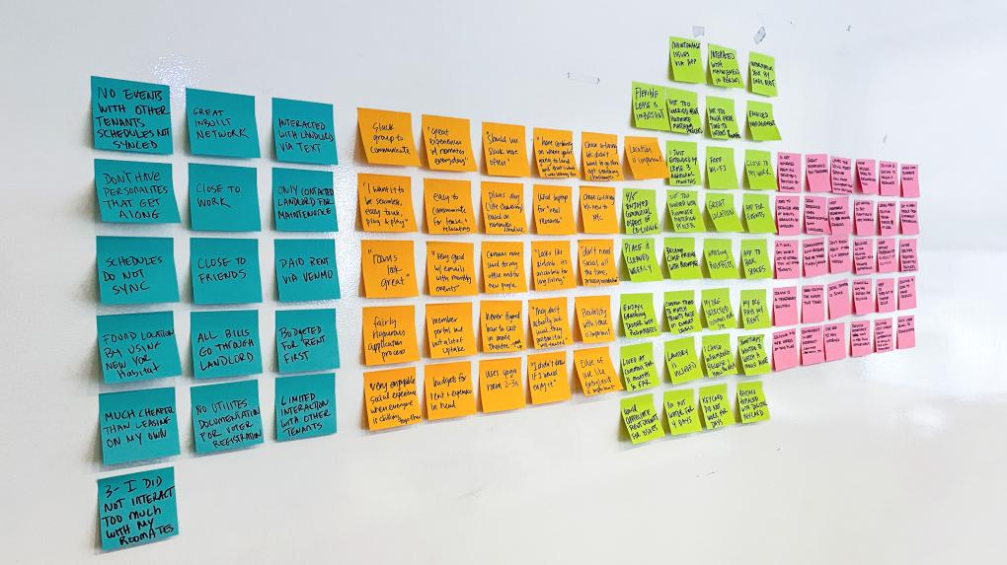
Affinity Map | Step 1
DEFINE
Notes:
SIMONE
affinity group | əˈfinədē ˌɡro͞op |
noun chiefly US
a group of people linked by a common interest or purpose.

Slide 10
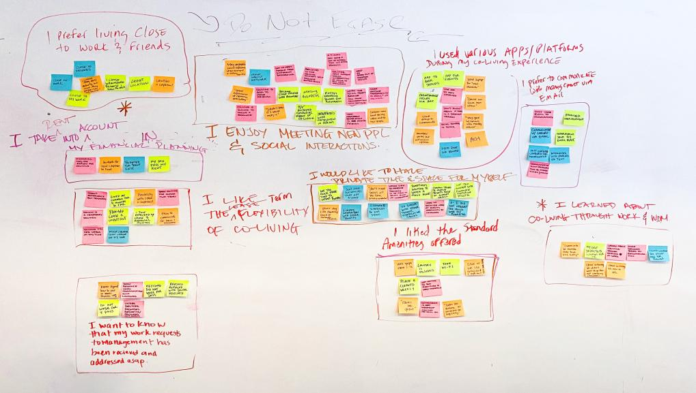
Affinity Map | Step 2
DEFINE
Notes:
SIMONE
Place observations into groupings based on similarities and trends.
affinity group | əˈfinədē ˌɡro͞op |
noun chiefly US
a group of people linked by a common interest or purpose.

Slide 11
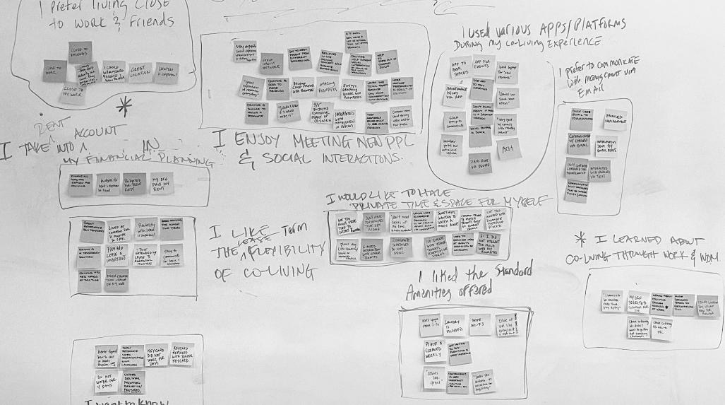
Affinity Map | Step 3
DEFINE
I want to know that my work requests to management has been received and addressed asap
I used various app/platforms during my co-living experience
I enjoy meeting new people and social interactions
I would like to have private time and space for myself
Huang | McFarlane | Paulino | Tobias
Notes:
SIMONE
Step back and refine and rename your groupings as many times as needed until the insights emerge.
I statements are “identifying insights”. Insights that we have gathered from those
I prefer living close to work and friends
I like the lease-term flexibility of co-living
I like the standard amenities offered
I prefer to communicate with management via email
I learned about co-living through work and word of mouth
I take rent into account my financial planning

Slide 12
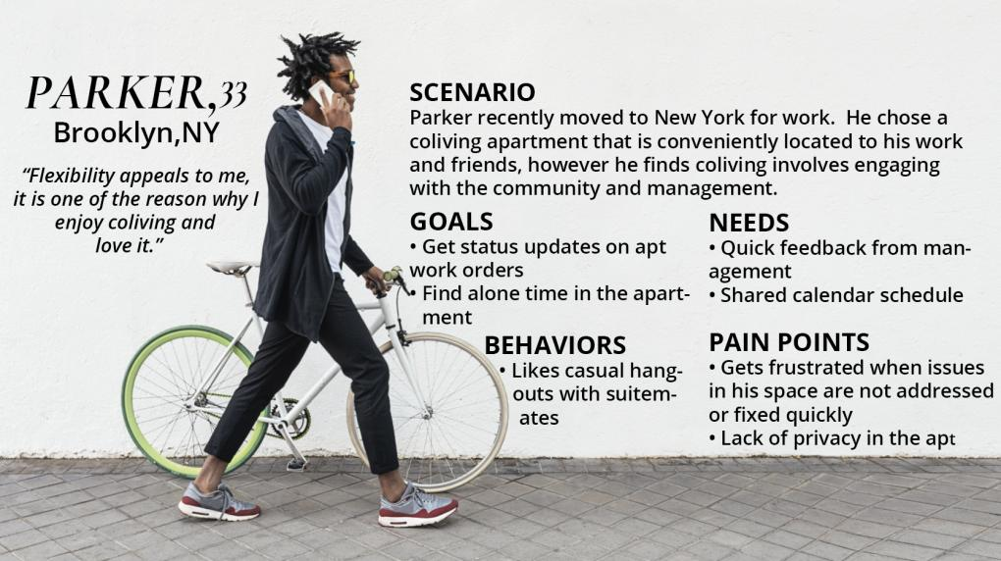
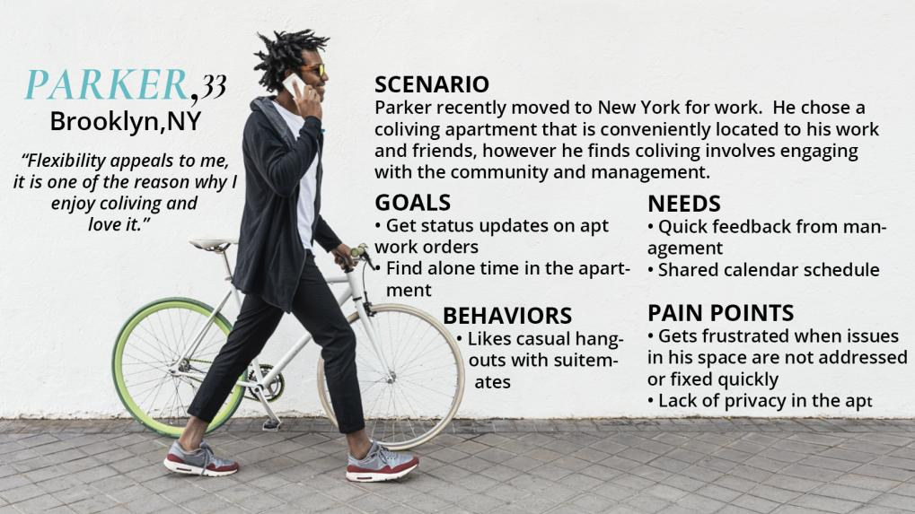
DEFINE
Huang | McFarlane | Paulino | Tobias
Notes:
SIMONE

Slide 13
Problem Statement
DEFINE
Individuals who are relocating to major cities are choosing coliving for the lease flexibility and a sense of community.
Huang | McFarlane | Paulino | Tobias
Notes:
SIMONE
FRANK
Example problem statement from lecture:
When patients are diagnosed with a serious condition, they are given a range of treatment options.
“Patrick is overwhelmed with the information available online, how might we help decide on the right treatment while weighing the factors that matter to him the most?

Slide 14
Problem Statement
DEFINE
Individuals who are relocating to major cities are choosing coliving for the lease flexibility and a sense of community.
Parker recently moved to New York and is coliving in Brooklyn. He enjoys the social and building amenities, but gets frustrated when communicating his needs with management and his suitemates.
Huang | McFarlane | Paulino | Tobias
Notes:
SIMONE
FRANK
Example problem statement from lecture:
When patients are diagnosed with a serious condition, they are given a range of treatment options.
“Patrick is overwhelmed with the information available online, how might we help decide on the right treatment while weighing the factors that matter to him the most?

Slide 15
Problem Statement
DEFINE
Individuals who are relocating to major cities are choosing coliving for the lease flexibility and a sense of community.
Parker recently moved to New York and is coliving in Brooklyn. He enjoys the social and building amenities, but gets frustrated when communicating his needs with management and his suitemates.
How might we help Parker improve the line of communication with management and suitemates within a coliving environment?
Huang | McFarlane | Paulino | Tobias
Notes:
SIMONE
FRANK
Example problem statement from lecture:
When patients are diagnosed with a serious condition, they are given a range of treatment options.
“Patrick is overwhelmed with the information available online, how might we help decide on the right treatment while weighing the factors that matter to him the most?

Slide 16
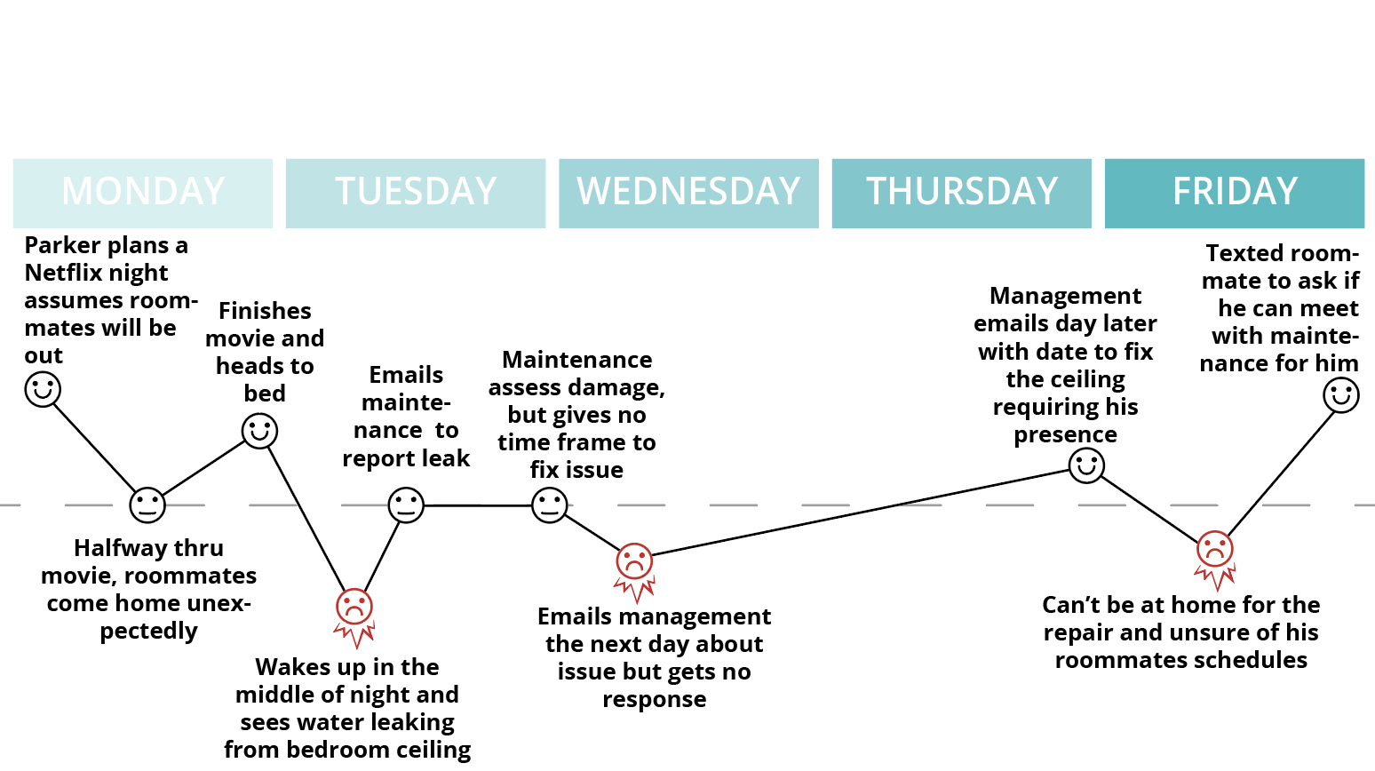
User Journey Map
DEFINE
Huang | McFarlane | Paulino | Tobias
Notes:
We need to verify the timeline

Slide 17
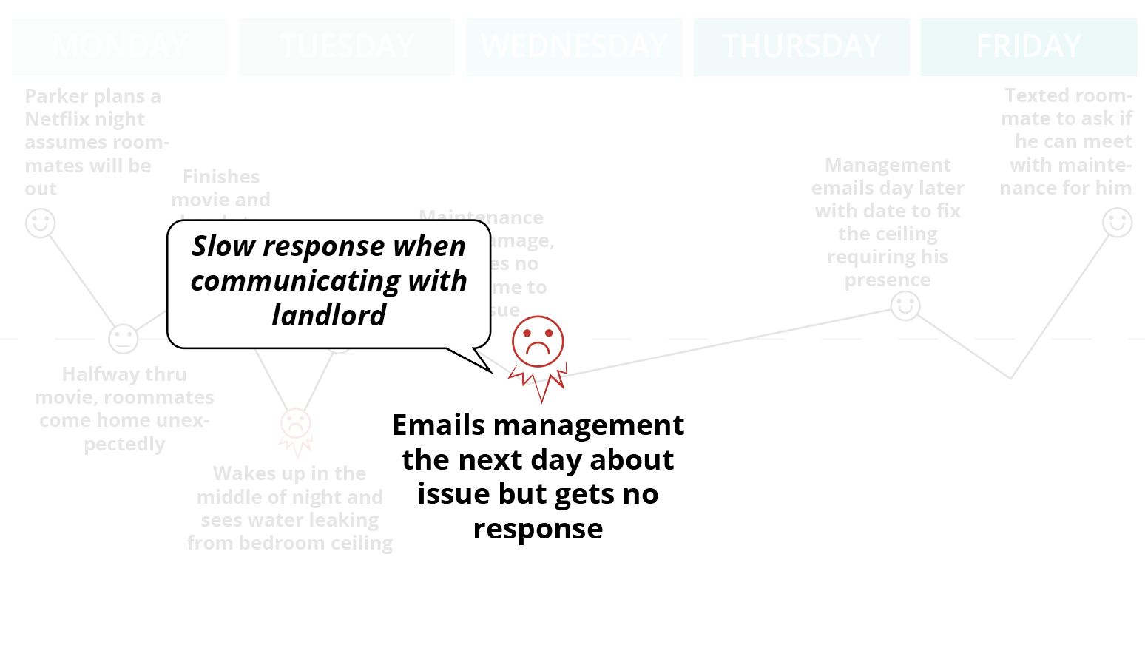
Opportunities
DEFINE
Find quicker way to communicate with management
Huang | McFarlane | Paulino | Tobias
Notes:
Find a quicker and effective way to communicate with management

Slide 18
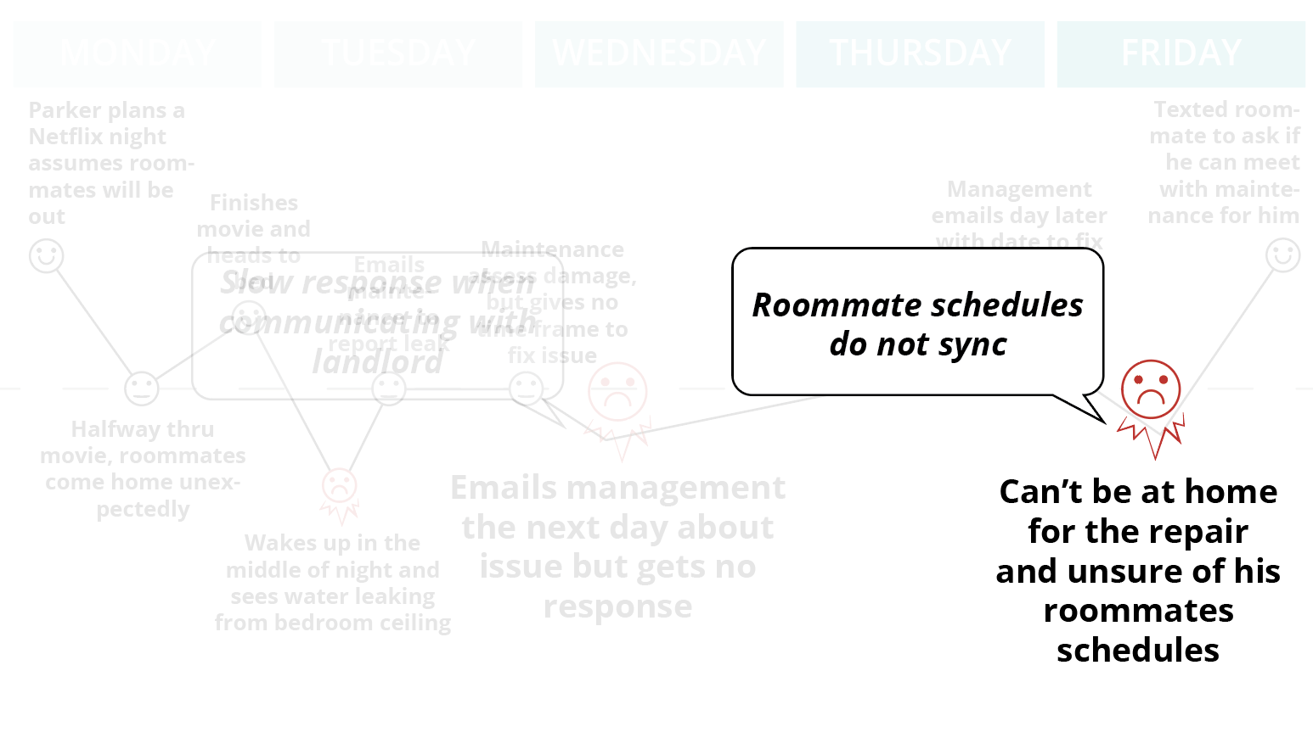
Opportunities
DEFINE
Find quicker way to communicate with management
Find a more effective way to connect with others from the community
Huang | McFarlane | Paulino | Tobias
Notes:
Find a more effective way to communicate with roommates and the community

Slide 19
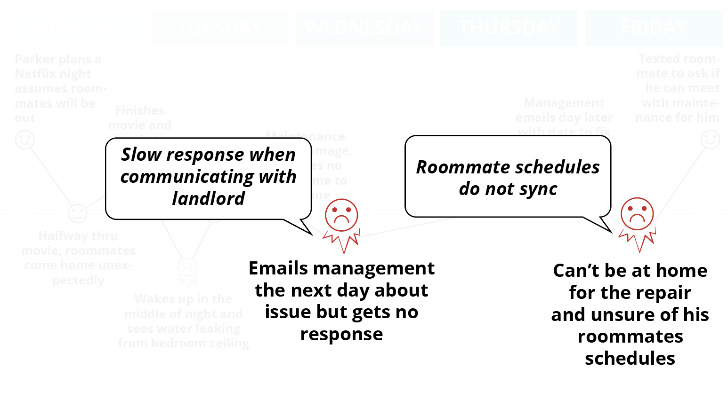
Opportunities
DEFINE
Find quicker way to communicate with management
Find a more effective way to connect with others from the community
Huang | McFarlane | Paulino | Tobias
Notes:
FRANK

Slide 20
MoSCoW Map
MUST Contact Mgmt - Chat/Call/Email Ticketing for service orders Roommate Calendar Events calendar/programming feed (channel) | SHOULD Account Portal (Rent payments, Billing documents) Amenities Schedule Set Preferences/Interests to share appropriate events
COULD Have discounts for nearby vendors/businesses Share nearby Neighborhood Events | WON’T New Application Portal Space Availability/Virtual Tours Ecommerce
Huang | McFarlane | Paulino | Tobias
Notes:
FRANK
Affinity Map I Statements:
-I want to know that my work requests to management has been received and addressed asap
-I enjoy meeting new people and social interactions
-I would like to have private time and space for myself
-I prefer to communicate with management via email
-I like the lease-term flexibility of co-living
-I like the standard amenities offered

Slide 21
Our Process
DESIGN THE RIGHT THING
DESIGN THINGS RIGHT
DISCOVER
DEFINE
DESIGN
DELIVER
Huang | McFarlane | Paulino | Tobias
Notes:
SALLY

Slide 22
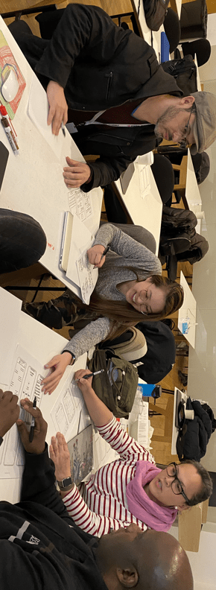
Design Studio
DESIGN
Huang | McFarlane | Paulino | Tobias
Notes:
SALLY
Send frank folder with images (DONE)
Add transition slide with context for each
Colorful borders (teal or orange) -- transition wise

Slide 23
Design Studio
DESIGN
MUST
Contact Mgmt - Chat/Call/Email
Ticketing for service orders
Roommate Calendar
Events calendar/programming feed (channel)
Huang | McFarlane | Paulino | Tobias
Notes:
SALLY
Send frank folder with images (DONE)
Add transition slide with context for each
Colorful borders (teal or orange) -- transition wise

Slide 24
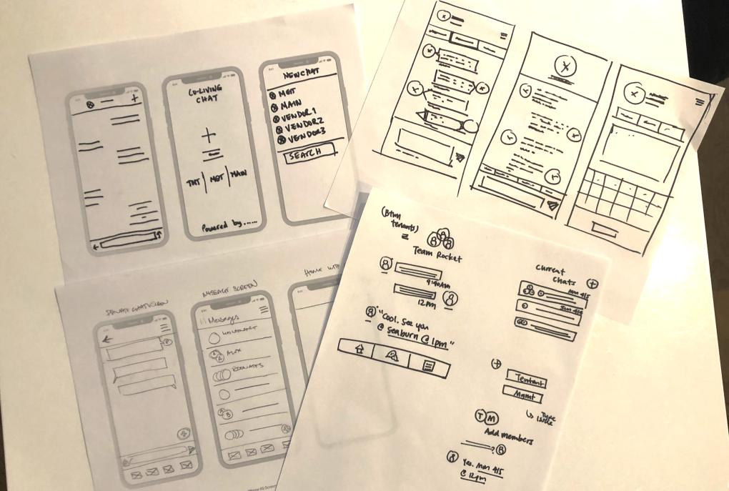
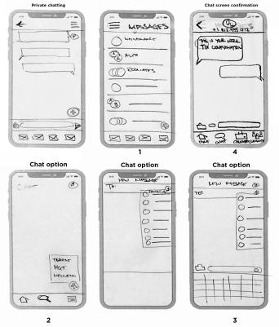
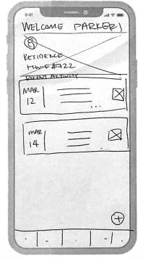
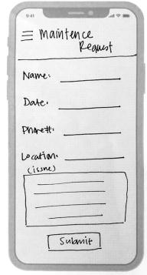
Design Studio- Converged
Home Page
Chat
Work Ticket
Huang | McFarlane | Paulino | Tobias
Notes:
SALLY
Send frank folder with images (DONE)
Add transition slide with context for each
Colorful borders (teal or orange) -- transition wise

Slide 25
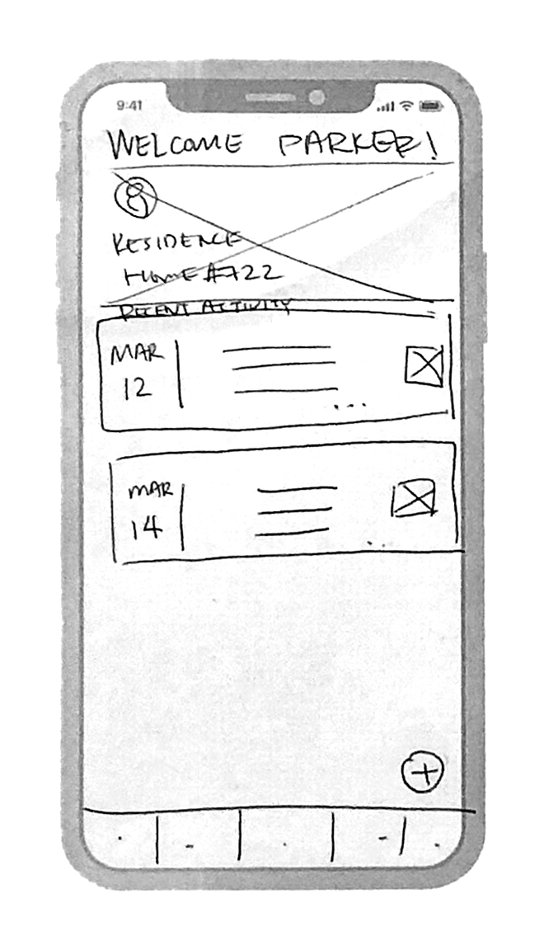
Design Studio- Converged
DESIGN
Home Page
1
Welcome message on homescreen
1
2
Activity Feed with notifications
2
3
3
Navigation Bar
Notes:
SALLY
Homepage:
-Standard Co-Living Welcome message on homescreen with tenant’s name and address
-Activity Feed with events tenant RSVPed to, and any important announcements like from housekeeping, maintenance, overall building announcements
-Standard Navigation Bar, highlighting icons that research shows are important to the user -- Home icon, Chat icon, Calendar icon, and a Community icon on our nav. bar

Slide 26
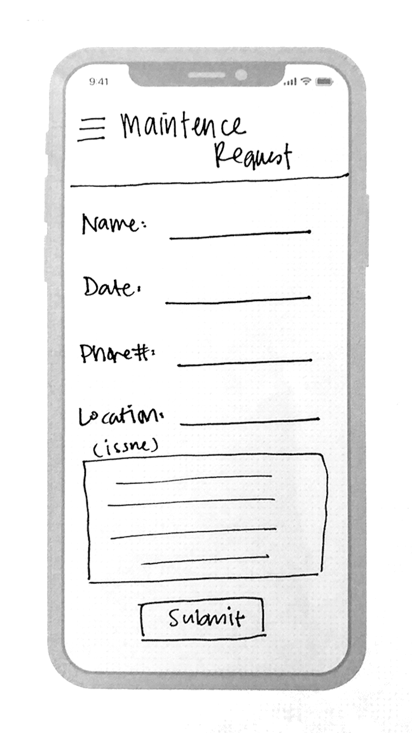
Design Studio- Converged
DESIGN
Work Ticket
1
1
Hamburger Menu
2
2
Phone number input
Notes:
SALLY
Work Ticket:
-We created a simple “Work Ticket form” created by a tenant direct to Maintenance for any issues a tenant may have.
We added the hamburger menu to users to go back to the menu bar settings if necessary
You’ll notice we have a phone # field. This is for an automatic text confirmation to be sent to the tenant.

Slide 27
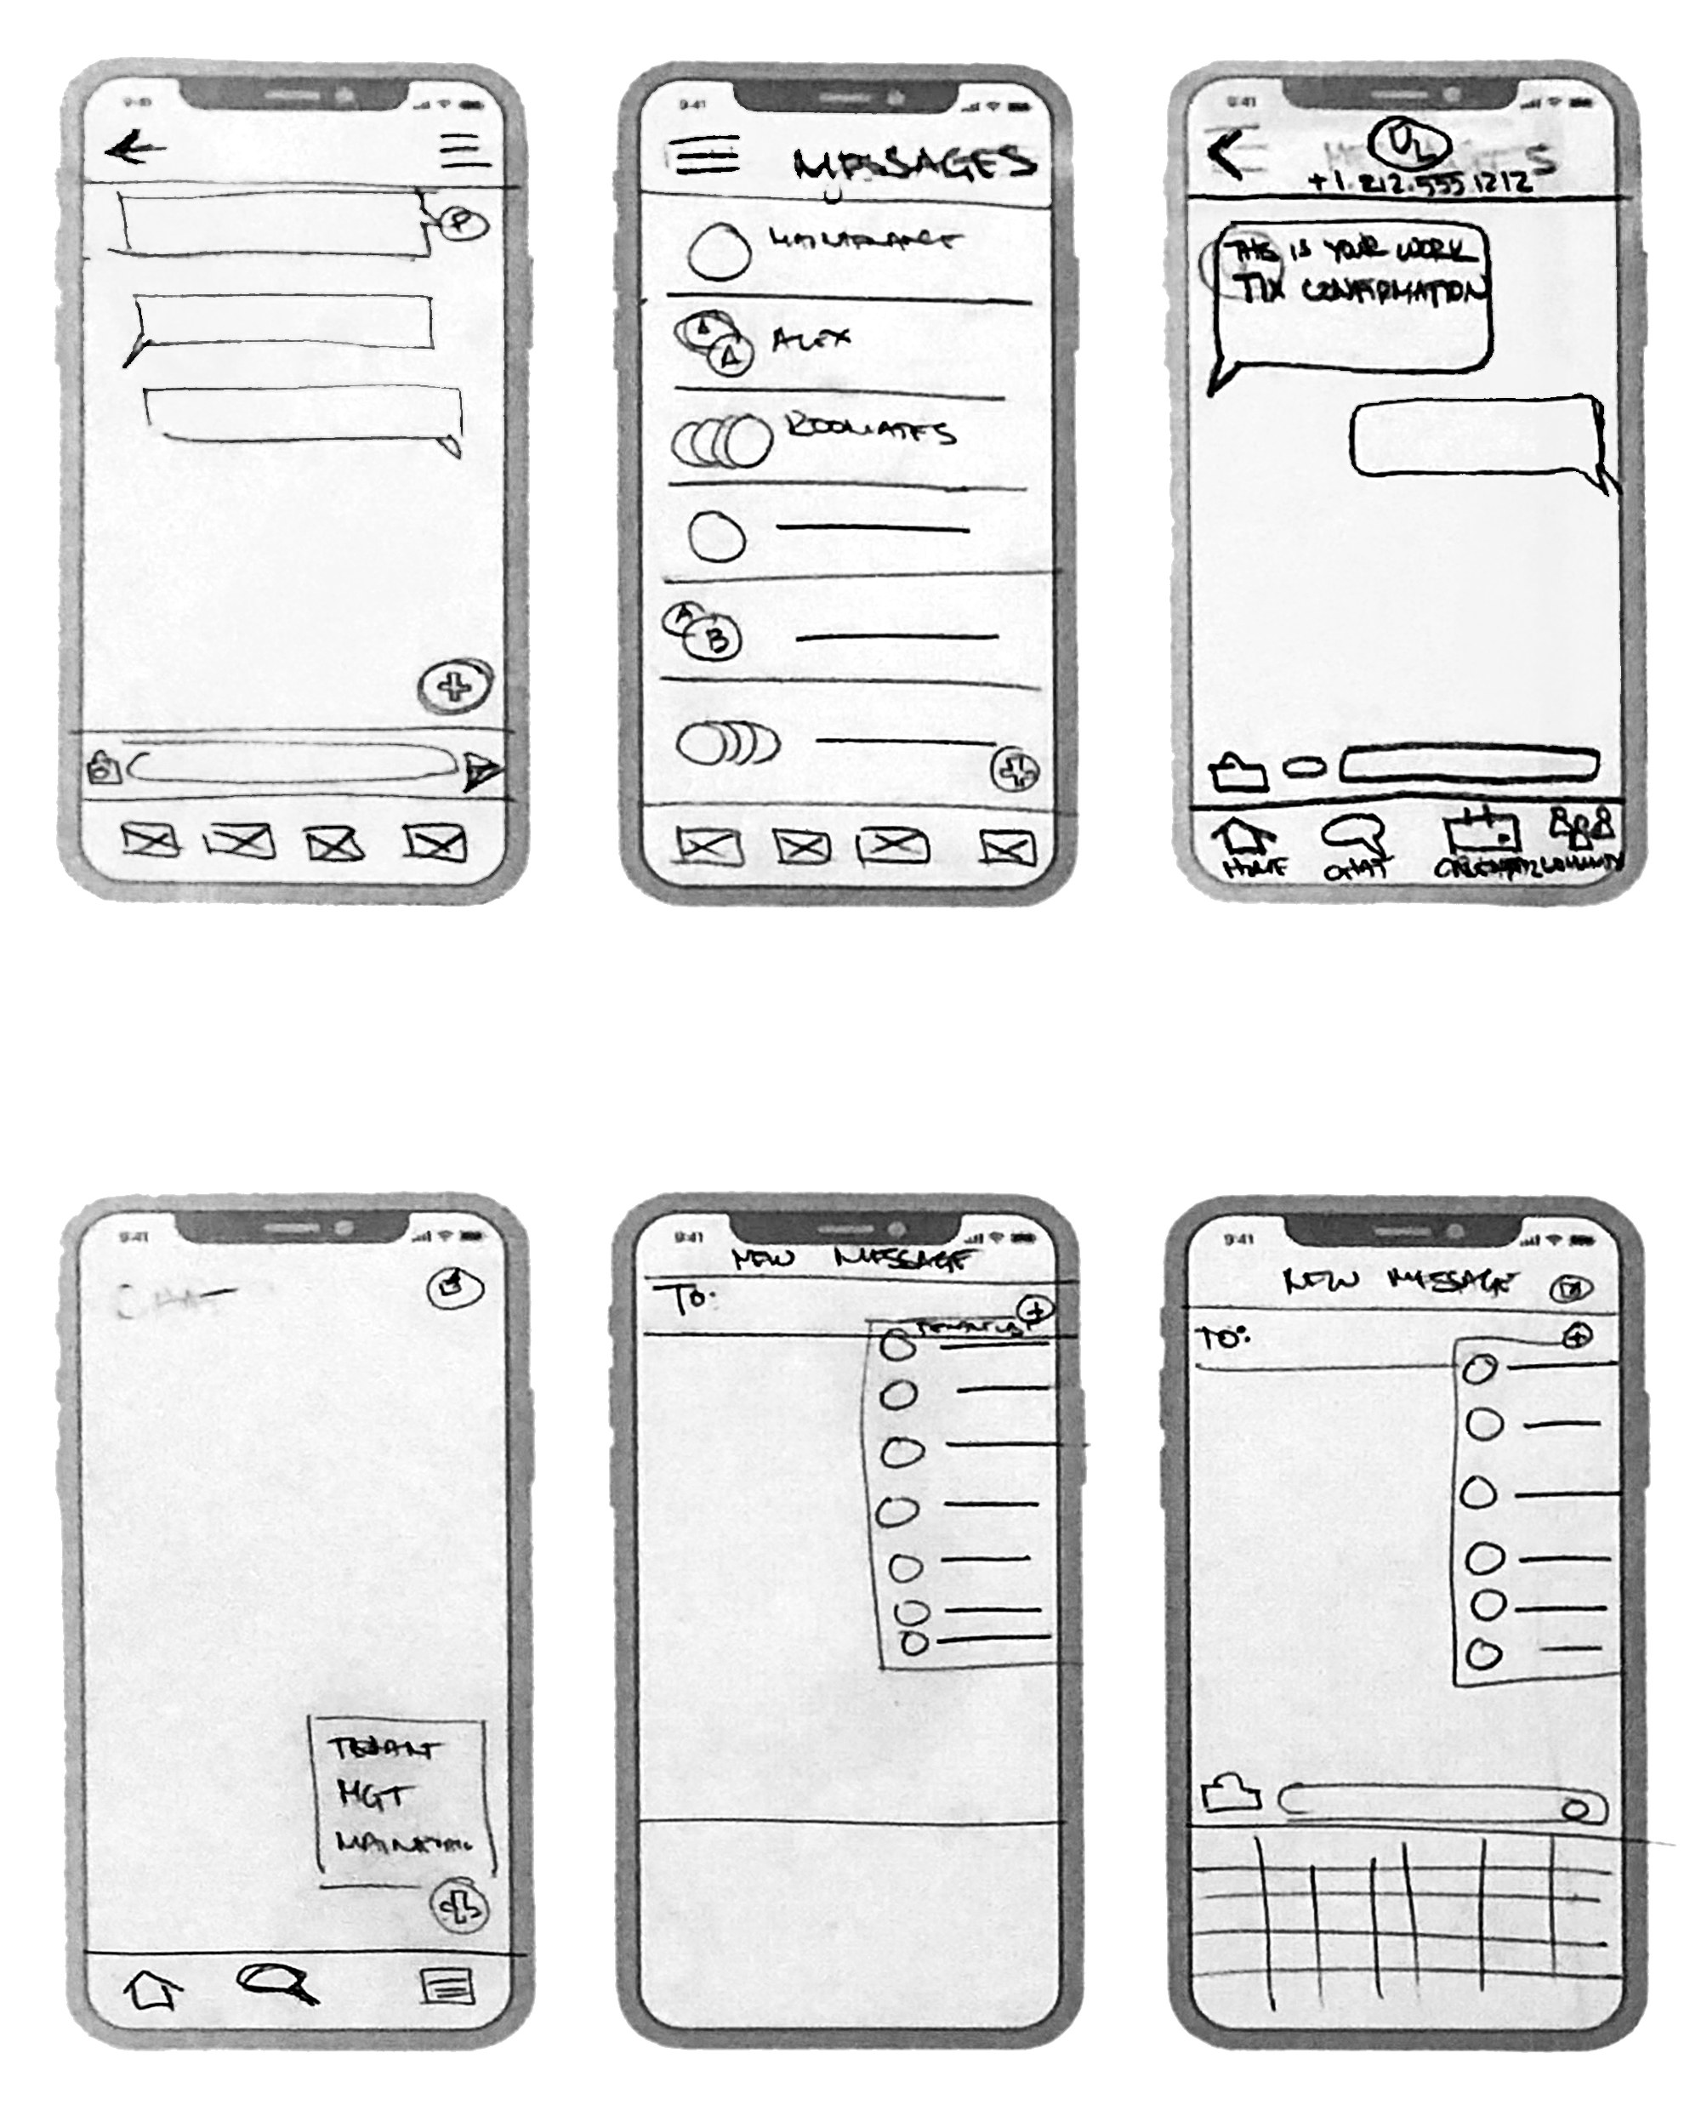
Design Studio- Converged
DESIGN
Chat
1
2
3
1
Private Chatting
2
Chat History
3
Chat Screen Confirmation
4
4
Chat options
Notes:
SALLY
Send frank folder with images (DONE)
Add transition slide with context for each
Colorful borders (teal or orange) -- transition wise
Chat:
-Our chat feature is inspired by iMessage on the iPhone. From research majority of our users has an iPhone and are familiar with iMessage
-So we have
1) What it looks like for a private message between any two people in the coliving building
2) Overview of all the messages sent with most recent being on top
3) We show what it would look like when Maintenance texts a confirmation text to the tenant who submitted the work ticket, and the ability to continue being in contact with Maintenance in that thread
4) Several chat options -- tapping on the compose message icon to see 3 options: to start a chat with a tenant, or with management, or with maintenance. The other two would show a list of suggested contacts maybe favorites or most recents to start a chat with

Slide 28
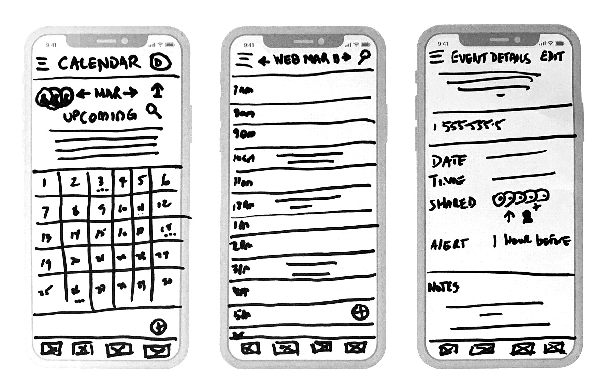
Design Studio- Converged
DESIGN
Shared Calendar
Shared Calendar with Suitemates and Maintenance
Notes:
SALLY
Shared Calendar:
-This is a shared calendar to improve communication between suitemates. Providing a smoother process and transparency amongst everyone. It is a standard calendar view. Maintenance appointments will also show up on the shared calendar

Slide 29
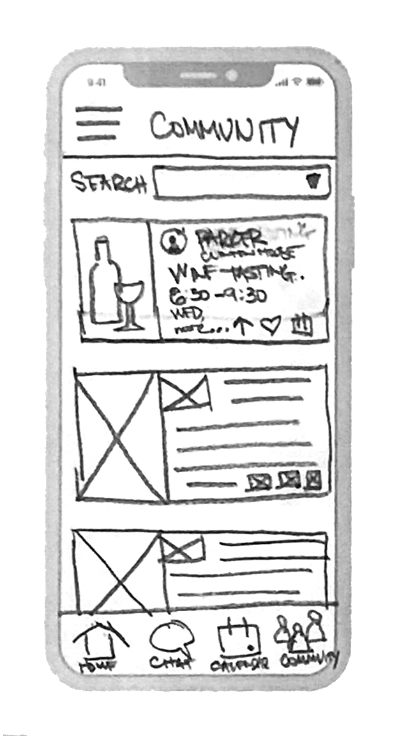
Design Studio- Converged
DESIGN
Community Feed
1
1
Filter Categories
2
2
RSVP, Heart it, Share it
Notes:
SALLY
Community Feed:
-Community is a crucial part to all the users based on research. We wanted to make sure the Community Feed for the co-living space is full of interesting events and workshops hosted by Management, tenant themselves, or vendors.
You can filter by community posts, community, events, educational workshops, and other categories.
On the Community Feed, you can RSVP, heart, and share an event on the community feed. Throughout time, the app will start recognizing the things you heart and RSVPed to, to start suggesting things that you may like up top for the next time you open the community feed

Slide 30
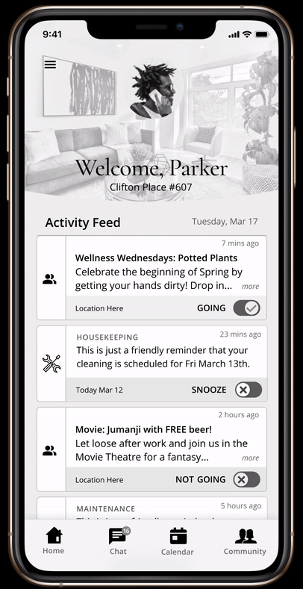
DESIGN
Mid-Fi Prototype
Huang | McFarlane | Paulino | Tobias
Notes:
DWAYNE
Do we need Mid-Fi prototype? Or just Hi-Fi

Slide 31
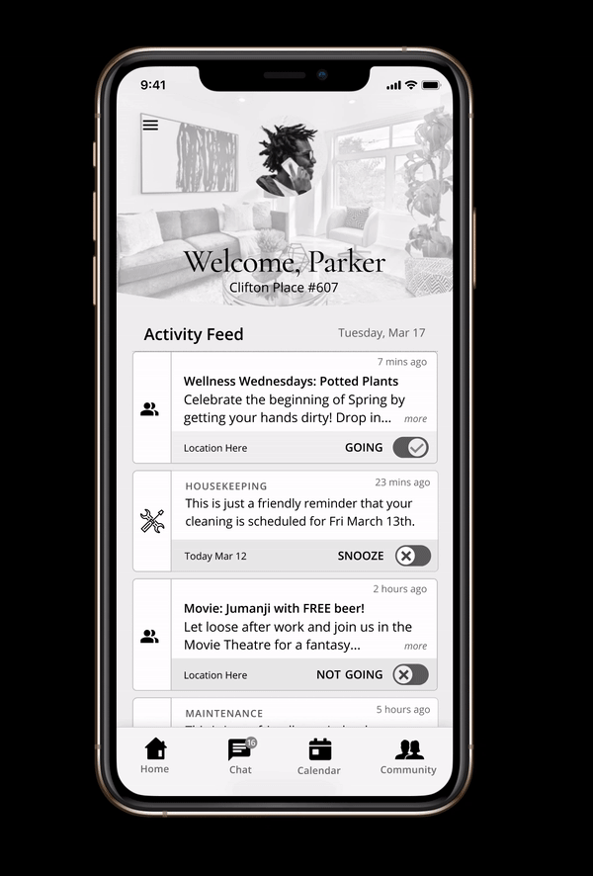
DESIGN
Scenario #1
There is a water leak in your apt. You need to report it to management
Task: Create a work ticket.
Screenshot of task 1
Notes:
DWAYNE

Slide 32
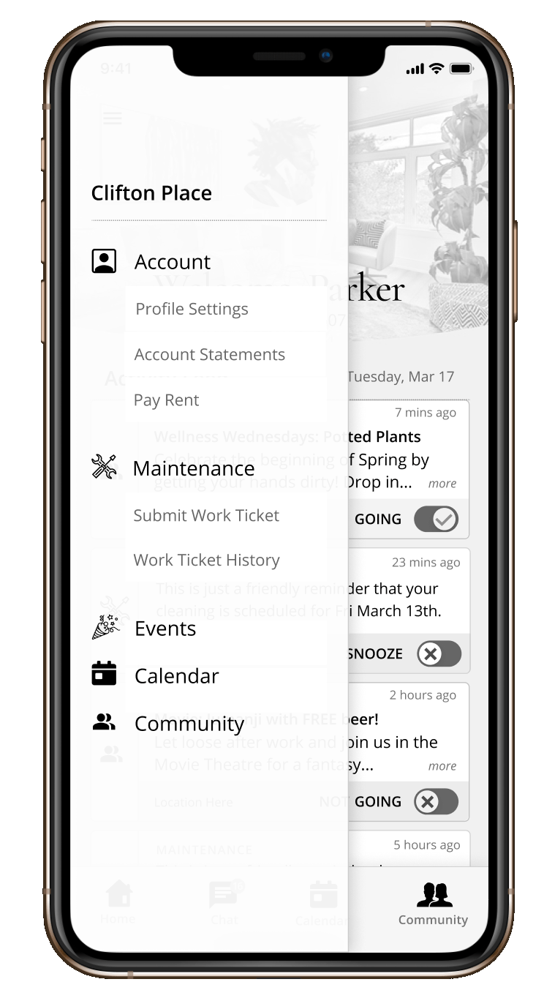
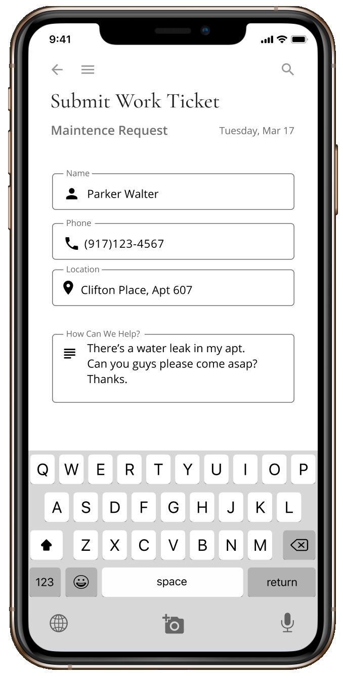
Mid-Fidelity Usability Test Report
Minor Issue
Feature 1: Submitting a Work Ticket
5/7 users successfully submitted a work ticket
1 user said she could reach maintenance
quicker if she sent a chat
Analysis:
Most users understood to find the work ticket form in the universal menu bar
2 users wanted a“submit” after filling out the form but because the iphone keyboard was out, she would have to tap “return”, in order to then tap the “submit” button
Recommendations:
Add a “Next” button on the screen
1
1
2
2
Home Screen - Menu Bar
Submit Work Ticket
Notes:
DWAYNE
Bold the yellow oval
And add 1,2 annotations (with analysis)

Slide 33
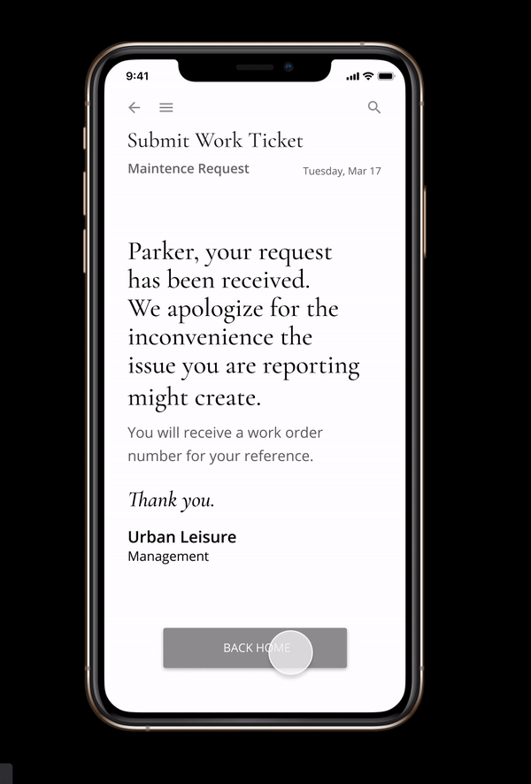
DESIGN
Scenario #2
You want to find out the status of the work ticket
Task: Send a text message to maintenance.
Screenshot of task 2
Notes:
DWAYNE

Slide 34
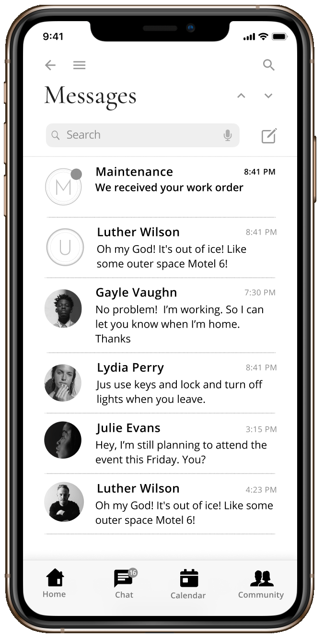
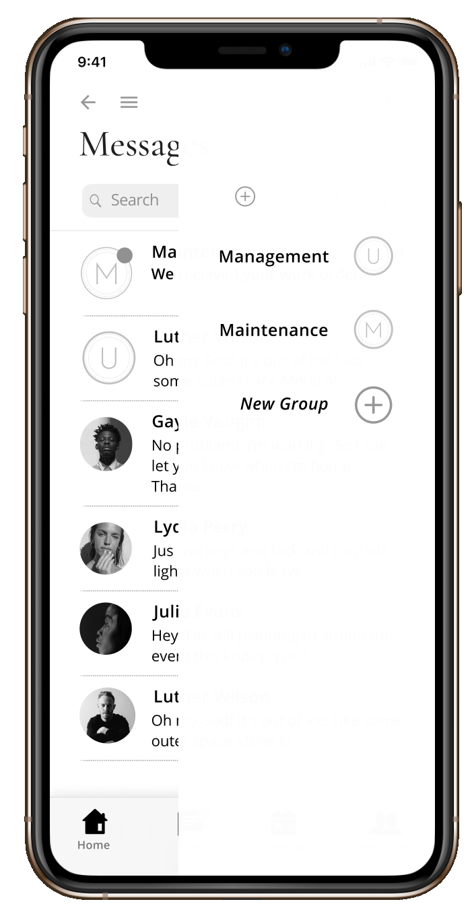
Mid-Fidelity Usability Test Report
Major Issue
Feature 2: Send a text to maintenance
4/7 users failed this task, and
4 users went to the menu bar and tapped “Work Tickets History”
3 users tapped on other buttons before completing the task
2
1
Analysis:
Most users remembered they went to the menu bar when submitting their ticket so users went to the menu bar to find the ticket first
Some users tapped on the ‘New Message’ icon
1
Home Screen -
Menu Bar
2
Work Ticket Text confirmation
Recommendations:
Add “chat” icon on Maintenance post in Activity Feed
Create route after tapping on Maintenance text
Start New text
Notes:
DWAYNE
Add ‘compose new text’ into analysis and add annotations

Slide 35
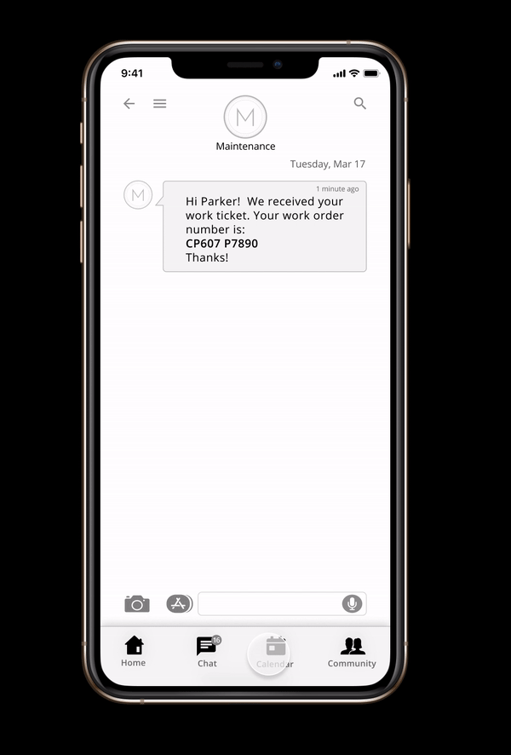
DESIGN
Scenario: #3
You want to schedule time in the apt for privacy
Task: Schedule your private time on the calendar
Screenshot of task 3
Notes:
DWAYNE

Slide 36
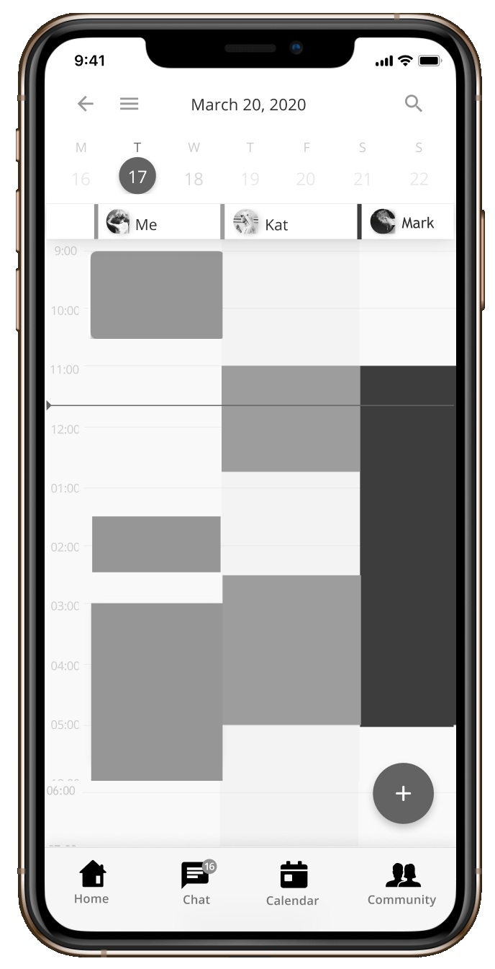
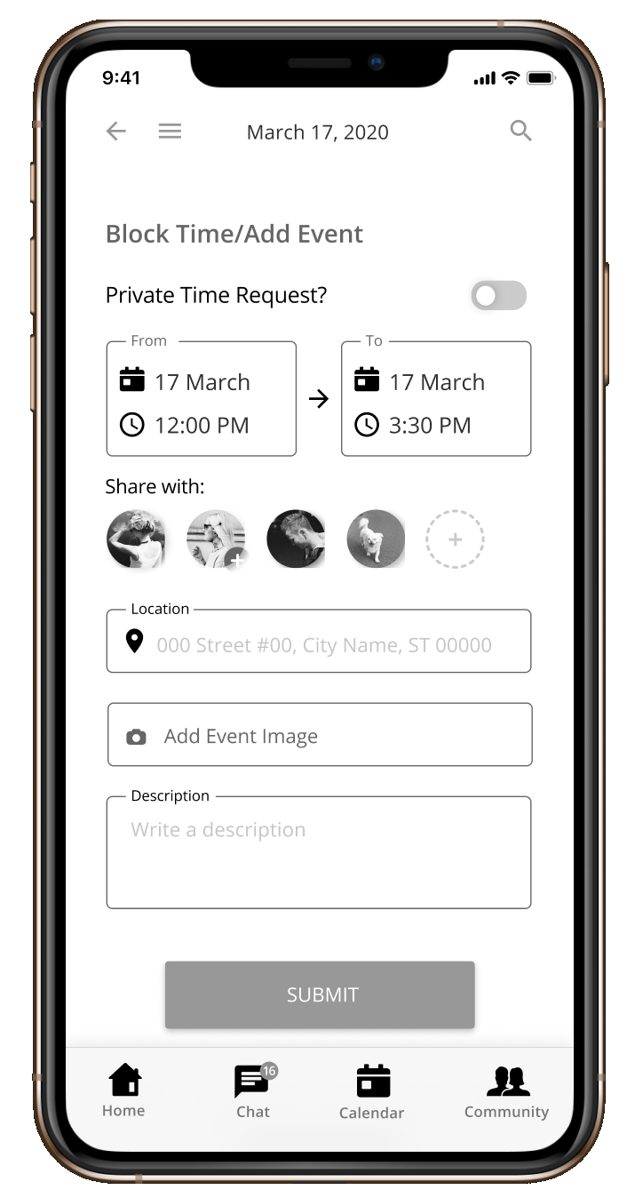
Mid-Fidelity Usability Test Report
Minor Issue
Feature 3: Schedule time for privacy on the calendar
7/7 users completed this task, but
2 were confused with the names in the calendar
4 users completed it without noticing the “private time” toggle
1
2
1
2
Analysis:
Users quickly located and used the f.a.b button
5 users told us their recommendations on how they perceived a calendar should look/work due to their experience
Recommendations:
Make private request transparent(overlay)
Move the Submit button to upper right due users knowledge with calendar formats
Calendar- Day view
Calendar- Add Event
Notes:
DWAYNE

Slide 37
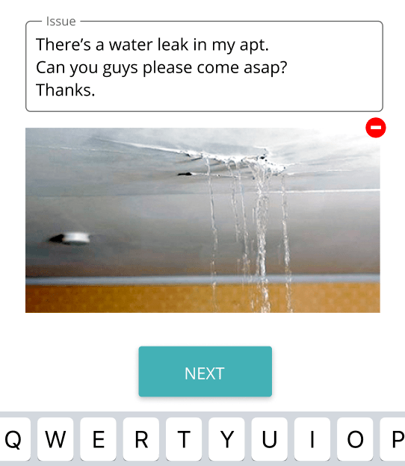
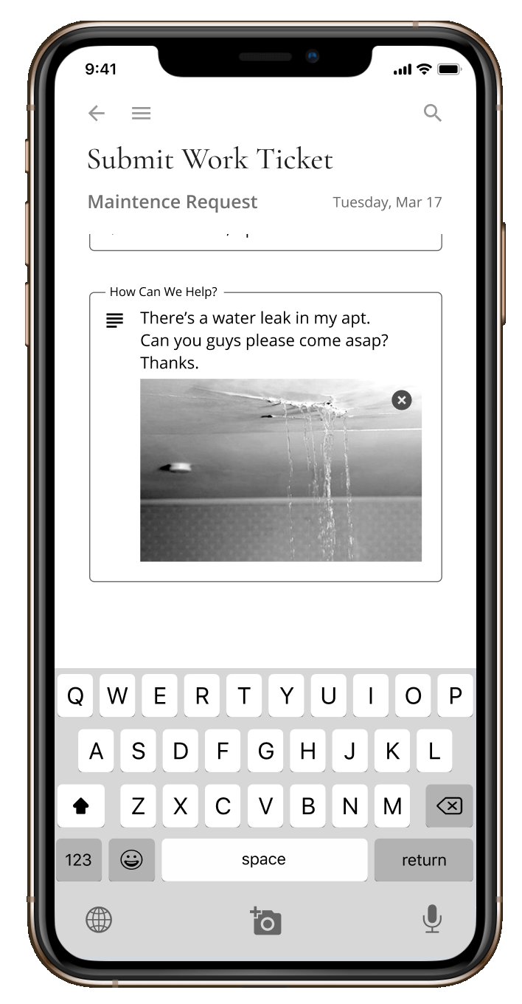
Work Ticket Screen - Revision
DESIGN
Recommendation:
Add a “Next” button on the screen
Submit Work Ticket
Revised w/ next button
Notes:
DWAYNE
Changes/Differences between mid-fi and hi-fi (only cropped hi-fi/zoomed in to show a preview)
Small and big mid fi and hi fi
Fix fonts

Slide 38
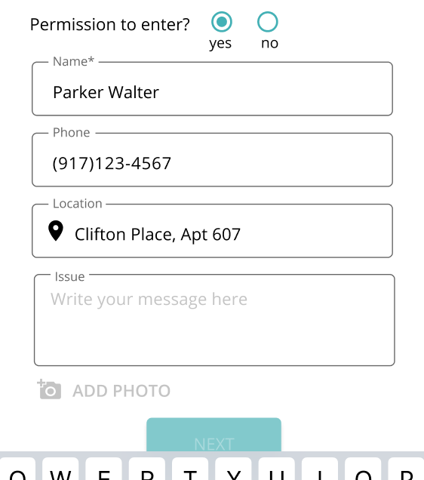
Work Ticket Screen - Revision
DESIGN
Recommendation:
Add a “Next” button on the screen
Enhancement:
Permission to enter authorization
Permission authorization
Submit Work Ticket
Submit Work Ticket
Notes:
DWAYNE
Changes/Differences between mid-fi and hi-fi (only cropped hi-fi/zoomed in to show a preview)
Small and big mid fi and hi fi
Fix fonts

Slide 39
Work Ticket Screen
DESIGN
Submit Work Ticket
Submit Work Ticket
Notes:
DWAYNE
Changes/Differences between mid-fi and hi-fi (only cropped hi-fi/zoomed in to show a preview)

Slide 40
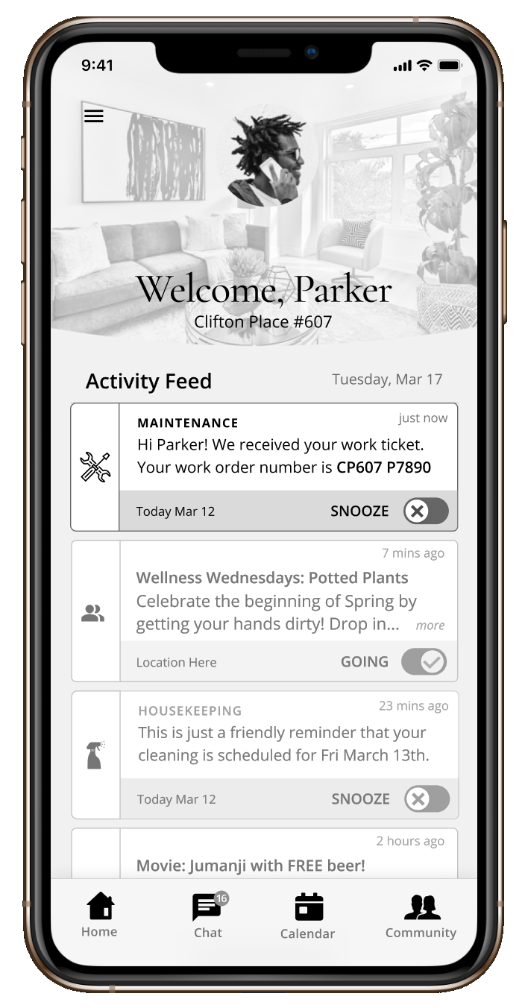
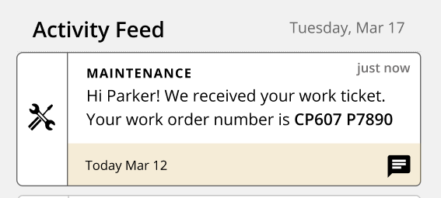
Get Updates from Maintenance - Revision
DESIGN
Recommendation:
Add “chat” icon on Maintenance post in Activity Feed
Quick chat icon - Activity feed
Home Screen- Maintenance update
Notes:
DWAYNE
Changes/Differences between mid-fi and hi-fi (only cropped hi-fi/zoomed in to show a preview)

Slide 41
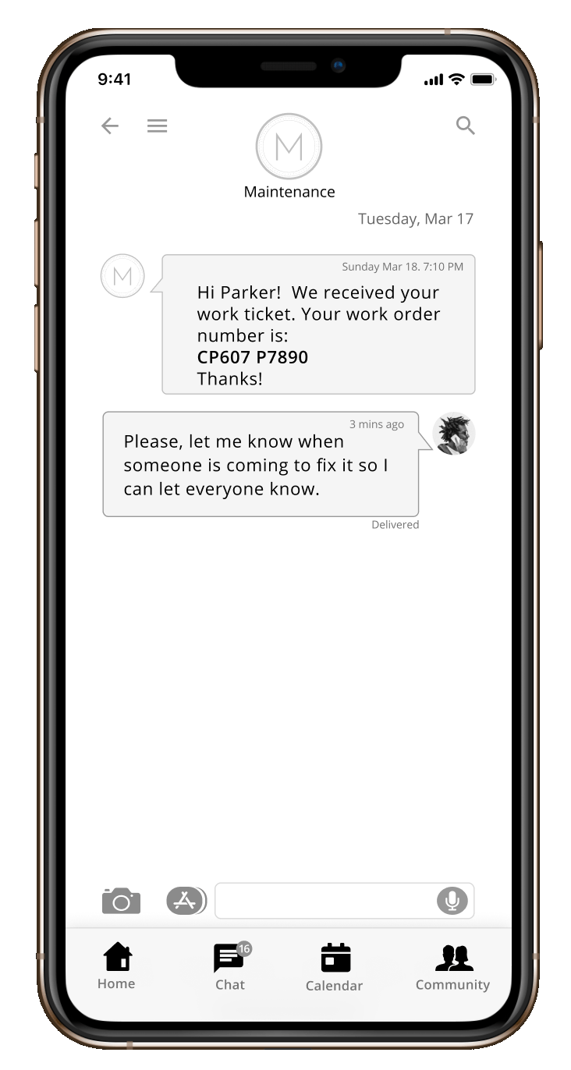
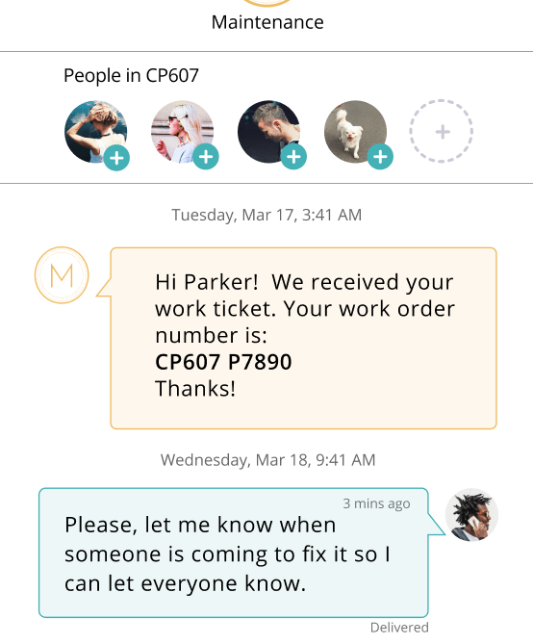
Get Updates from Maintenance - Revision
DESIGN
Recommendation:
Add “chat” icon on Maintenance post in Activity Feed
Enhancement:
Create group chat with roommates
Optional Roommate add
Home Screen- Maintenance update
Work Ticket Text confirmation
Notes:
DWAYNE
Changes/Differences between mid-fi and hi-fi (only cropped hi-fi/zoomed in to show a preview)

Slide 42
Get Updates from Maintenance - Revision
DESIGN
Work Ticket Text confirmation
Home Screen- Maintenance update
Notes:
DWAYNE
Changes/Differences between mid-fi and hi-fi (only cropped hi-fi/zoomed in to show a preview)

Slide 43
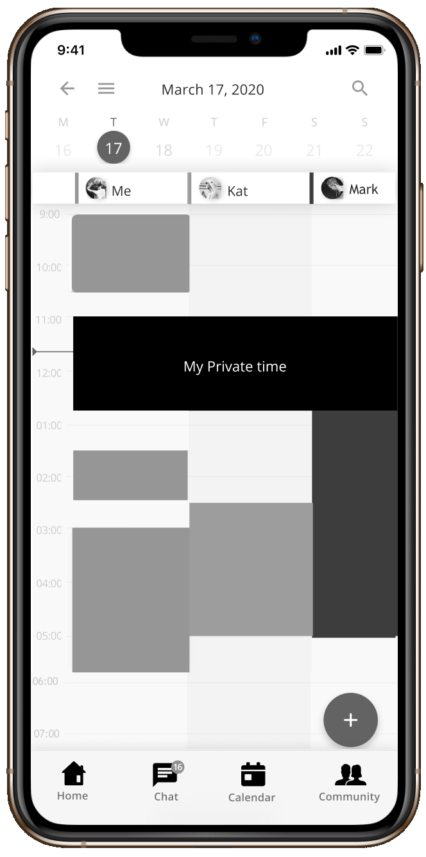
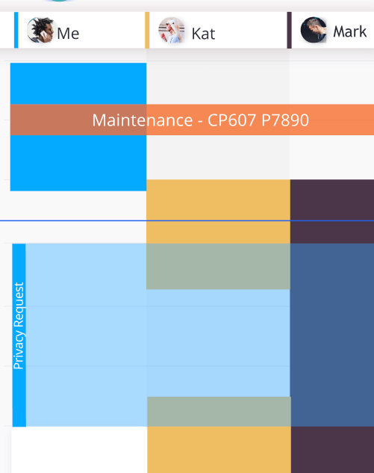
Request Private time on Shared Calendar - Revision
DESIGN
Recommendation:
Make private request transparent(overlay)
Private Time Request Overlay
Calendar- Day view
Notes:
DWAYNE
Changes/Differences between mid-fi and hi-fi (only cropped hi-fi/zoomed in to show a preview)
Arrow pointing to changes
Labels with mid fi to hifi

Slide 44
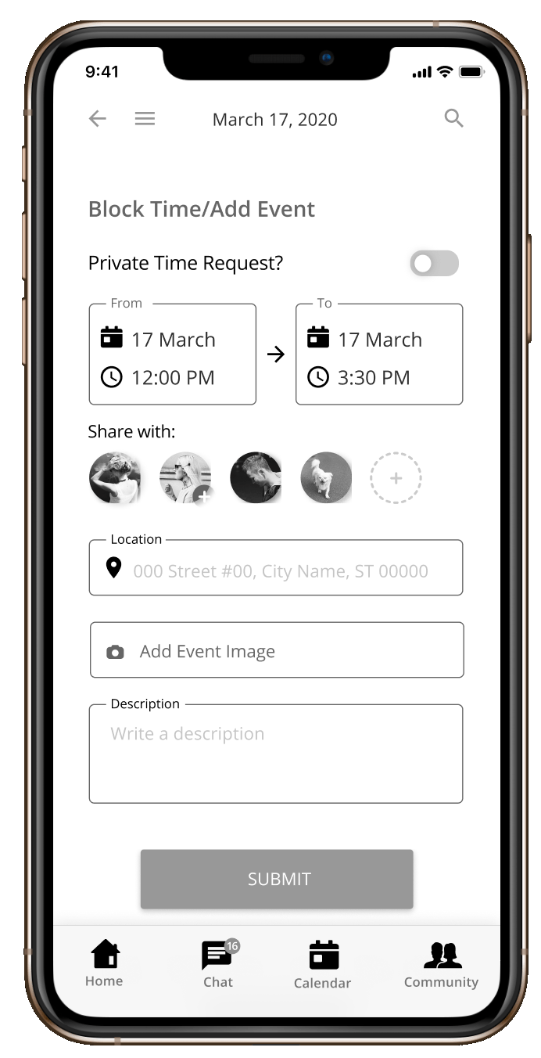
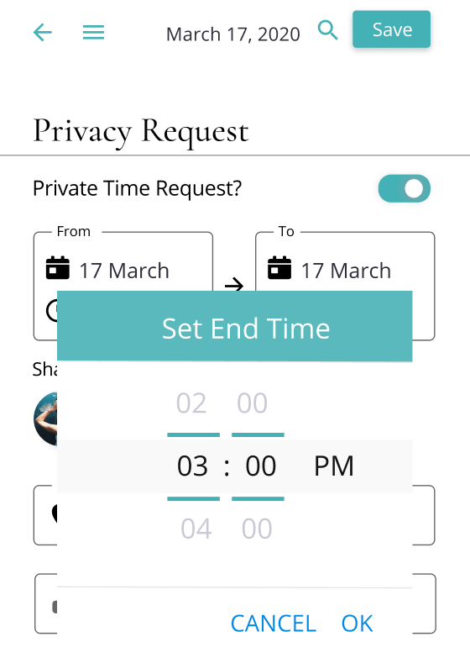
Request Private time on Shared Calendar - Revision
DESIGN
Recommendations:
Make private request transparent(overlay)
Enhancement:
Moved submit button
Repositioned save button
Calendar- Day view
Calendar- Add Event
Notes:
DWAYNE
Changes/Differences between mid-fi and hi-fi (only cropped hi-fi/zoomed in to show a preview)
Arrow pointing to changes
Labels with mid fi to hifi

Slide 45
Request Private time on Shared Calendar
DESIGN
Calendar- Add Event
Calendar- Day view
Notes:
DWAYNE
Changes/Differences between mid-fi and hi-fi (only cropped hi-fi/zoomed in to show a preview)
Arrow pointing to changes
Labels with mid fi to hifi

Slide 46
HI-FI Prototype
Notes:
FRANK

Slide 47



COMPETITIVE & COMPARATIVE ANALYSIS
Categories | Client | Competitor |  |  | Comparator
 | Urban Leisure
FEATURES
Account Portal(Invoice, Preferences, Documents) | X | ✓ | ✓ | ✓ | ✓
Chat/Email/Text Tenant-Mgmt | X | ✓ | ✓ | ✓ | ✓
Community Feed | X | ✓ | ✓ | X | ✓
Shareable Calendars | X | X | X | X | X
Personal Feed | X | X | X | ✓ | ✓
Educational Workshops | ✓ | X | X | X | X
Community Events, Activities, & Programming | X | ✓ | ✓ | ✓ | ✓
Features in current sprint.
Features for next steps
Notes:
FRANK
DWAYNE RESIZE COMPETITOR LOGOS
UL will differentiate due to educational aspect
DWAYNE
Highlighting what feature we made for her app, then highlight in diff color what we’re going to work on (educational workshops) and gray out everything else
Black and bold
SHOULDS:
-housekeeping schedule
-set new tenant profiles/preferences

Slide 48
COMPETITIVE & COMPARATIVE ANALYSIS
Categories | Client | Competitor |  |  | Comparator
 | Urban Leisure
FEATURES
Account Portal(Rent, Balances, Documents) | X | ✓ | ✓ | ✓ | ✓
View Room Availability | X | ✓ | ✓ | ✓ | ✓
Building/Staff Information | ✓ | ✓ | ✓ | ✓ | ✓
Chat/Email/Text Tenant-Mgmt | X | ✓ | ✓ | ✓ | ✓
Community Feed | X | ✓ | ✓ | X | ✓
Shareable Calendars | X | X | X | X | X
Personal Feed | X | X | X | ✓ | ✓
Community Messaging | X | ✓ | X | X | ✓
Educational Workshops | ✓ | X | X | X | X
Smart home features | X | X | ✓ | X | X
Community Events, Activities, & Programming | X | ✓ | ✓ | ✓ | ✓

Slide 49
Next Steps
Conduct Usability Tests on Hi-Fi Prototype
Build screen for Account Portal (Rent payments, Billing documents)
Incorporate Educational Programing of Urban Leisure
Explore flow for other target user: New Tenants
Huang | McFarlane | Paulino | Tobias
Notes:
FRANK

Slide 50
Enjoy!
Huang | McFarlane | Paulino | Tobias
Notes:
FRANK

Slide 51
Affinity Map | Step 1
DEFINE

